Slide 1



SCHOOL OF DATA SCIENCE & FORECASTING
PROBLEM: “VEHICLE HOTSPOT ZONE”
2024-2025
~DATA DEVIANS PRESENTS

Slide 2

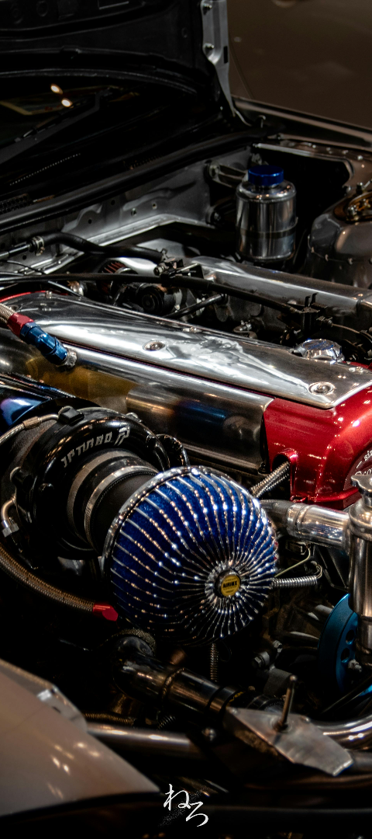
Introduction to the Problem Statement
Causes of Overheating
Factors like extreme weather conditions and low coolant levels can lead to engine overheating.
Signs of Vulnerability
Vulnerable vehicle components include the radiator, water pump, and thermostat.
3. Impact on Performance
Engine overheating can cause irreversible damage and affect vehicle performance.

Slide 3
Understanding the Concept of Vehicle Hotspot Zone
Definition
Identification
Impact
Vehicle Hotspot Zone refers to areas with high traffic density and increased accident rates, leading to congestion and safety issues.
These zones are often identified by analyzing historical traffic data and accident reports, pinpointing trouble spots.
Understanding these zones can aid in city planning, traffic management, and enhanced safety measures.

Slide 4

Importance of Data Science in Addressing the Problem
1
Data-driven Insights
2
Predictive Modeling
3
Optimized Solutions
Data science provides valuable insights into traffic patterns and accident occurrences, aiding in hotspot identification.
Utilizing predictive models helps in forecasting potential hotspot zones based on historical data and patterns.
Data science enables the development of optimized solutions for traffic management and urban planning.

Slide 5

Importance of Identifying Hotspot Zones
Preventive Maintenance
Enhanced Safety
Early identification helps in maintaining vehicle health and preventing breakdowns.
Reducing the risk of accidents and fires arising from overheating vehicles.
Cost Savings
Preventing major repairs and avoiding costly damage caused by engine overheating.

Slide 6
Factors Affecting Coolant Temperature
Engine Speed
Vehicle Speed
Accelerator Pedal Position
Total Distance

Slide 7
Roadmap for Solving the Problem Using Data Science
1
2
3
Data Collection
Exploratory Analysis
Model Development
Collecting comprehensive data on traffic patterns, accident records, and vehicle movement.
Conducting in-depth data analysis to identify patterns, trends, and potential hotspot areas.
Creating machine learning models for accurate prediction and visualization of hotspot zones.

Slide 8

Step 1: Data Collection and Preprocessing
1
Data Sources
Identifying and gathering data from various sources, including traffic cameras, sensors, and GPS logs.
2
Data Cleaning
Removing inconsistencies, errors, and irrelevant data to ensure a clean dataset for analysis.
3
Normalization
Standardizing the data to ensure consistency and accuracy in further analysis and modeling.

Slide 9




Step 2: Exploratory Data Analysis and Visualization
Pattern Identification
Identifying recurring traffic patterns and anomaly detection using exploratory data analysis techniques.
Visualization Techniques
Utilizing advanced visualization tools to represent complex traffic data in an understandable format.
Trend Analysis
Conducting trend analysis to understand traffic flow variations and potential hotspot areas.

Slide 10

Step 3: Machine Learning Model Development
Feature Selection
Model Training
Identifying relevant features from the data to construct an effective machine learning model.
Training machine learning algorithms using historical data to predict hotspot zones with high accuracy.
Evaluation
Assessing model performance and refining algorithms to enhance predictive capabilities.

Slide 11
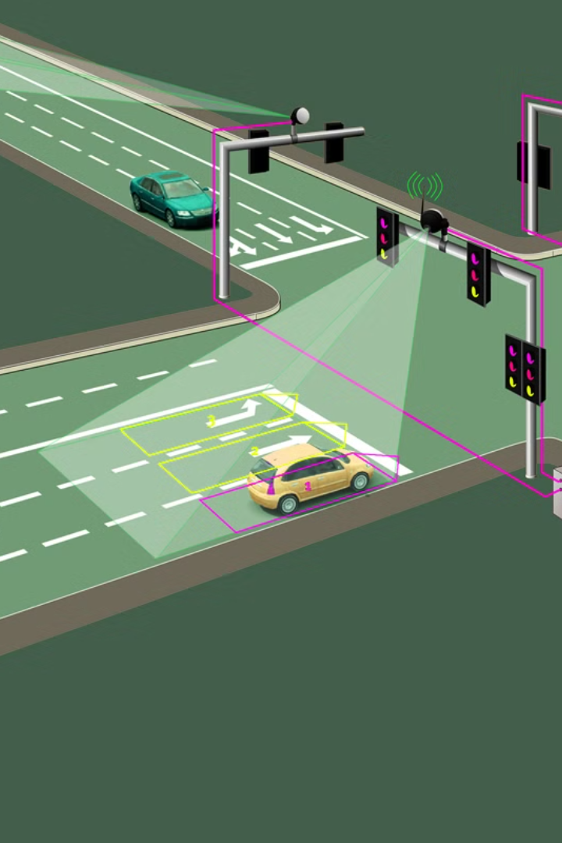
Conclusion
Identified the scenarios in which vehicle consider under the hotspot zone:
High Coolant Temperature
Driving Behavior
High Traffic Congestion
Accident Prone Area
Area with security concerns

